Slide 1

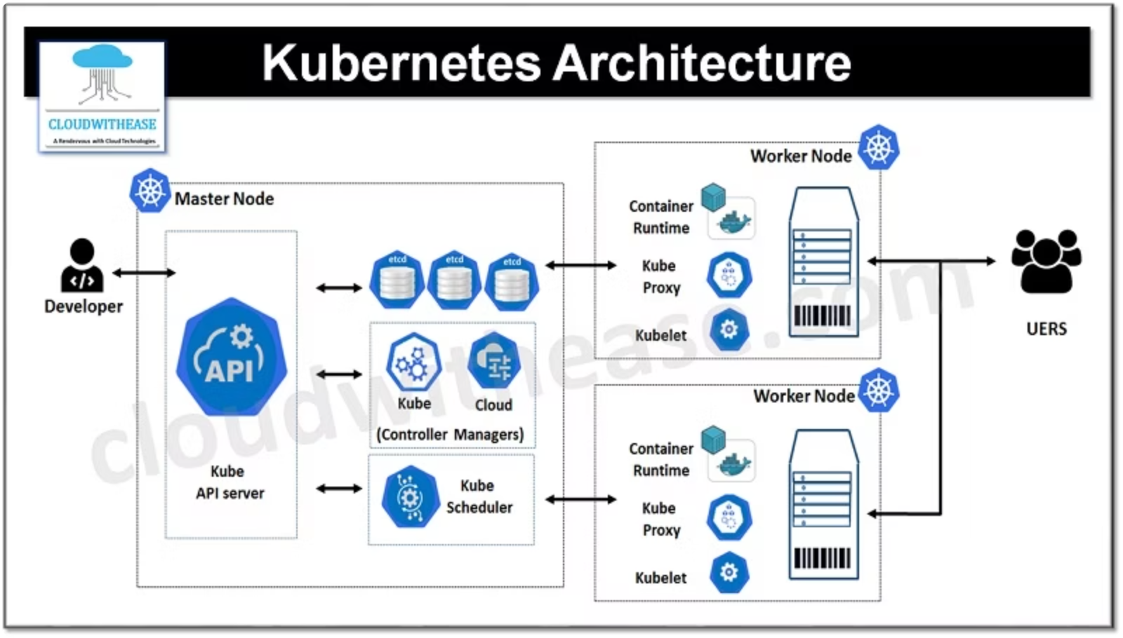
Kubernetes Networking: Service Discovery & Communication
Welcome to this deep dive into Kubernetes networking. This presentation will guide you through the essential components that enable seamless communication within your clusters and with external services. We'll cover key concepts to help you build and manage robust Kubernetes environments.
Understanding Core Interactions
How Pods, Services, and external traffic communicate.
The Flat Networking Model
Exploring the foundational principle behind Kubernetes network design.
Service Types Explained
Differentiating between ClusterIP, NodePort, LoadBalancer, and ExternalName services.
Ingress Controllers
Managing external access to services within the cluster.
Kubernetes DNS
How service discovery works through DNS resolution.
Network Policies
Implementing security and traffic control within your cluster.

Slide 2

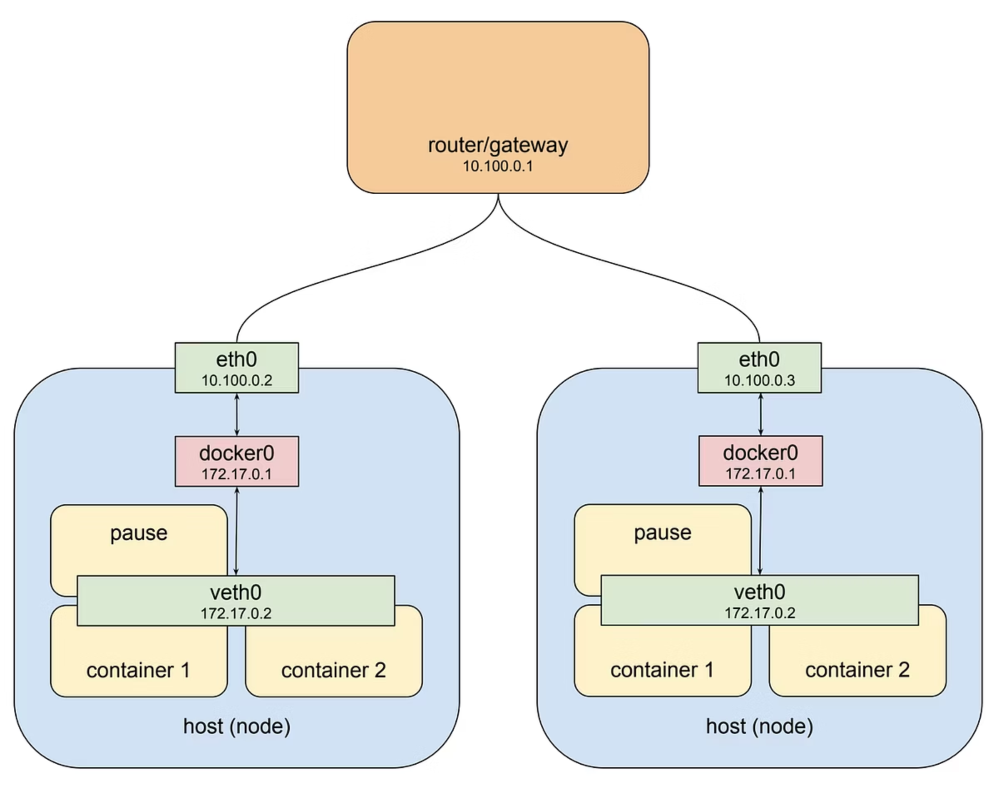
Kubernetes Networking
Architectural Components: Laying the Foundation
This slide introduces the core architectural components that form the backbone of Kubernetes networking, as visualized in the diagram above. We will explore each key layer that enables seamless communication within your cluster and with the external world.
Pods: Fundamental Units
The smallest deployable units, receiving IP addresses for direct communication.
Services: Stable Access Points
Provide consistent network endpoints for dynamic Pods, ensuring reliable traffic distribution.
Ingress: External Gateway
The entry point for external traffic, routing requests to appropriate Services.
Network Policies: Traffic Control
Define rules for secure communication between Pods and Services within the cluster.
Notes:
Welcome everyone! Today we'll focus on how Pods, Services, and external traffic interact in Kubernetes. We'll also see how DNS and Network Policies play a role in creating secure, reliable networking for your applications. This is a critical topic for anyone running production workloads in Kubernetes.

Slide 3






Learning Goals
Flat Networking Model
Enabling direct communication between all Pods within the cluster.
Service Types
Exposing applications via ClusterIP, NodePort, and LoadBalancer services.
Ingress Controllers
Advanced HTTP/HTTPS routing for external access to services.
DNS & Service Discovery
Automatic service discovery and resolution using CoreDNS.
Network Policies
Securing workloads by controlling Pod-to-Pod communication.
Speaker Notes: These are our key learning objectives for today. By the end of this session, you should have a solid understanding of these five core networking concepts in Kubernetes. We'll cover both theory and practical examples, culminating in a hands-on lab where you'll implement these concepts yourself.

Slide 4
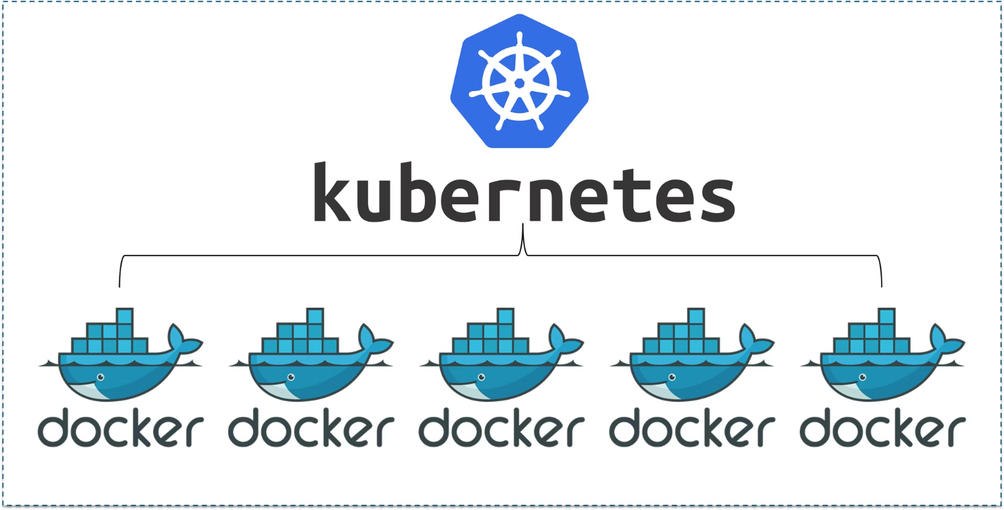

Pod-to-Pod Networking: The Flat Network Model
In Kubernetes, a fundamental concept is the flat network model. This means:
Unique IP Addresses
Every Pod within the cluster receives its own unique IP address.
Direct Communication
All Pods can communicate directly with each other, regardless of which node they reside on, without the need for Network Address Translation (NAT).
How it's Implemented: CNI Plugins
As shown in the diagram, Pod A (on Node 1) can directly reach Pod B (on Node 2) using their unique IP addresses.
This seamless communication is enabled by Container Network Interface (CNI) plugins. These plugins configure the network within and between nodes, ensuring the flat network model is maintained:
Flannel: A simple and widely used overlay network solution.
Calico: Provides robust networking and comprehensive network policy enforcement.
Cilium: Leverages eBPF for high-performance networking and advanced security features.
Speaker Notes: Unlike Docker bridge networking, Kubernetes ensures Pods across nodes can reach each other directly. This flat network model is fundamental to Kubernetes architecture. The CNI plugins handle the complex networking details, allowing developers to focus on applications rather than networking configuration. Each Pod gets its own IP address and can communicate with any other Pod in the cluster without NAT translation, which simplifies application design.

Slide 5




Services: Stable Endpoints for Ephemeral Pods
Kubernetes Pods are ephemeral and can change IP addresses when they restart or scale. Services provide stable, consistent network access to a set of Pods, ensuring applications can always find each other.
ClusterIP (Internal Only)
NodePort (Node Exposure)
LoadBalancer (External Access)
The default service type, providing a stable internal IP address. Perfect for Pod-to-Pod communication within the cluster.
Exposes the service on a specific port across all cluster Nodes, making it accessible from outside the cluster.
Integrates with external cloud provider load balancers to provide a public IP and distribute traffic automatically.
Accessible only from inside the cluster
Access via <NodeIP>:<NodePort>
Provides a public, external IP
Stable IP and DNS name
NodePort range: 30000-32767
Automatic traffic distribution
Ideal for microservice communication
Useful for development and testing
Essential for production workloads
Speaker Notes: Services are a fundamental Kubernetes concept that solve the problem of Pod ephemerality. When Pods restart or scale, their IP addresses change, which would break connections. Services provide stable endpoints that don't change, even as the underlying Pods come and go. The three main service types serve different purposes: ClusterIP for internal communication, NodePort for development and testing, and LoadBalancer for production workloads that need external access. Each type builds on the previous one, adding more functionality.

Slide 6
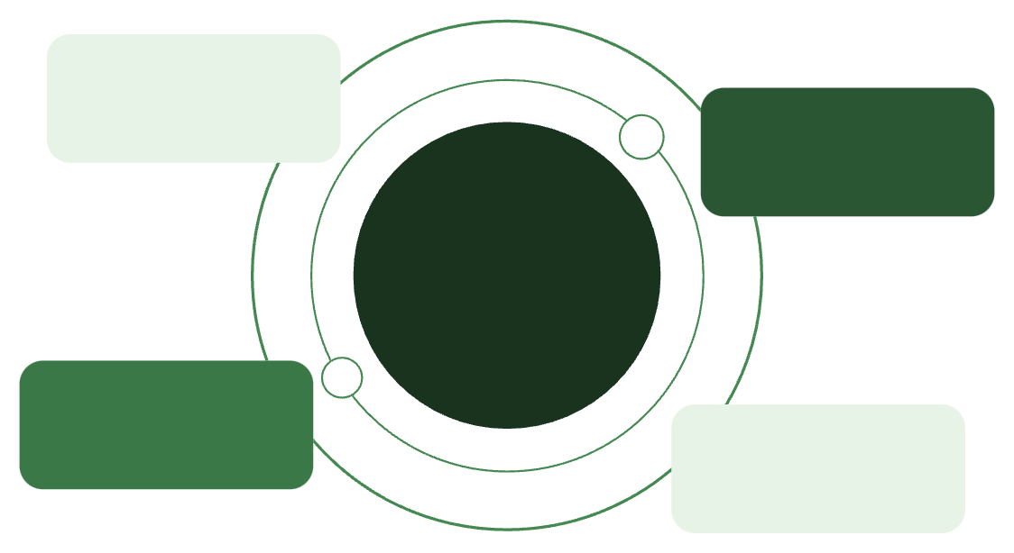
Service YAML Example
ClusterIP Service Definition
Anatomy of a Service
This YAML defines a basic ClusterIP Service, which provides stable network access to a set of Pods within the cluster.
The Service acts as an internal load balancer, directing traffic to Pods that match its defined selector.
apiVersion: v1kind: Servicemetadata: name: nginx-svcspec: selector: app: nginx ports: - port: 80 targetPort: 80 type: ClusterIP
selector
Crucially identifies which Pods the Service should manage, based on their labels (e.g., app: nginx).
port
The port on which the Service itself listens for incoming connections from other services or applications.
targetPort
The port on the Pod (container) where the actual application is listening for traffic. This is where the Service forwards requests.
type
Defines how the Service is exposed: ClusterIP (internal), NodePort (on nodes), or LoadBalancer (external with cloud provider integration).
Client Services
Other services send requests to ClusterIP
nginx-svc
ClusterIP Service named "nginx-svc"
ClusterIP Service
Stable internal endpoint for app: nginx Pods
Label Selector
Selects Pods with label app: nginx
Backend Pods
Multiple nginx Pods receive traffic
Speaker Notes: Let's examine a typical Service YAML definition. The selector field is crucial - it determines which Pods receive traffic from this Service based on their labels. In this example, any Pod with the label 'app: nginx' will receive traffic. The port is what other services will connect to, while the targetPort is where the application in the Pod is actually listening. The Service acts as a stable proxy, load balancing requests across all matching Pods. This abstraction layer is what allows Kubernetes to handle Pod scaling and failures transparently to clients.

Slide 7
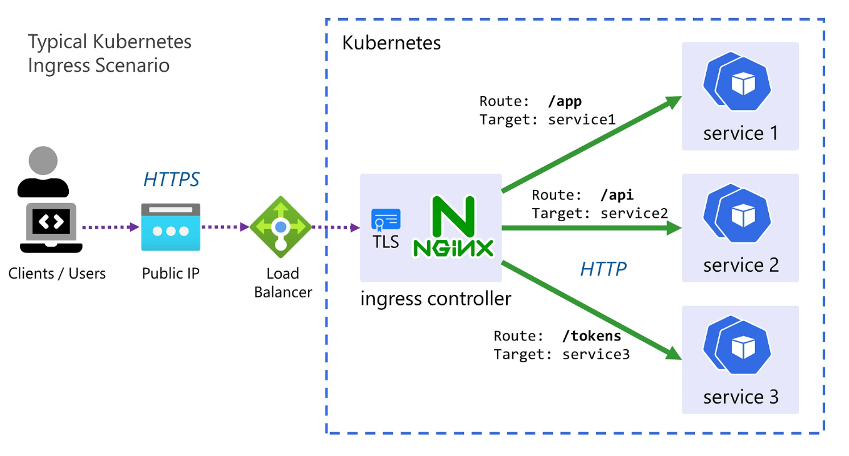

Beyond Basic Services: Introducing Ingress Controllers
Why Ingress?
While Services effectively expose applications within Kubernetes, they often fall short for complex external traffic management:
Basic Services (NodePort, LoadBalancer) provide limited features for external access.
They lack native support for advanced HTTP/HTTPS routing, such as path-based routing or SSL termination.
Advanced Traffic Routing
Enhanced Features
Manages HTTP/HTTPS traffic by defining rules to direct requests to different backend Services.
Supports critical web application needs like SSL termination, name-based virtual hosting, and load balancing.
Ingress in Action: Routing Example
Flexible & Extensible
An Ingress Controller acts as an intelligent traffic manager, directing incoming requests based on defined rules:
Requires an Ingress Controller implementation (e.g., NGINX, HAProxy, Traefik) to process these rules.
shop.example.com → Routes to the Frontend Service
api.example.com → Routes to the Backend Service
example.com/blog → Routes to the Blog Service
Speaker Notes: Ingress controllers solve the limitations of basic Service types by providing advanced HTTP routing capabilities. While Services are great for simple exposure of applications, Ingress gives you fine-grained control over HTTP traffic. This is particularly useful for web applications where you might want different paths or hostnames to route to different services. For example, you could route /api to your backend service and everything else to your frontend. Remember that Ingress is just a set of rules - you need an actual Ingress Controller implementation like NGINX, HAProxy, or Traefik to process these rules.

Slide 8
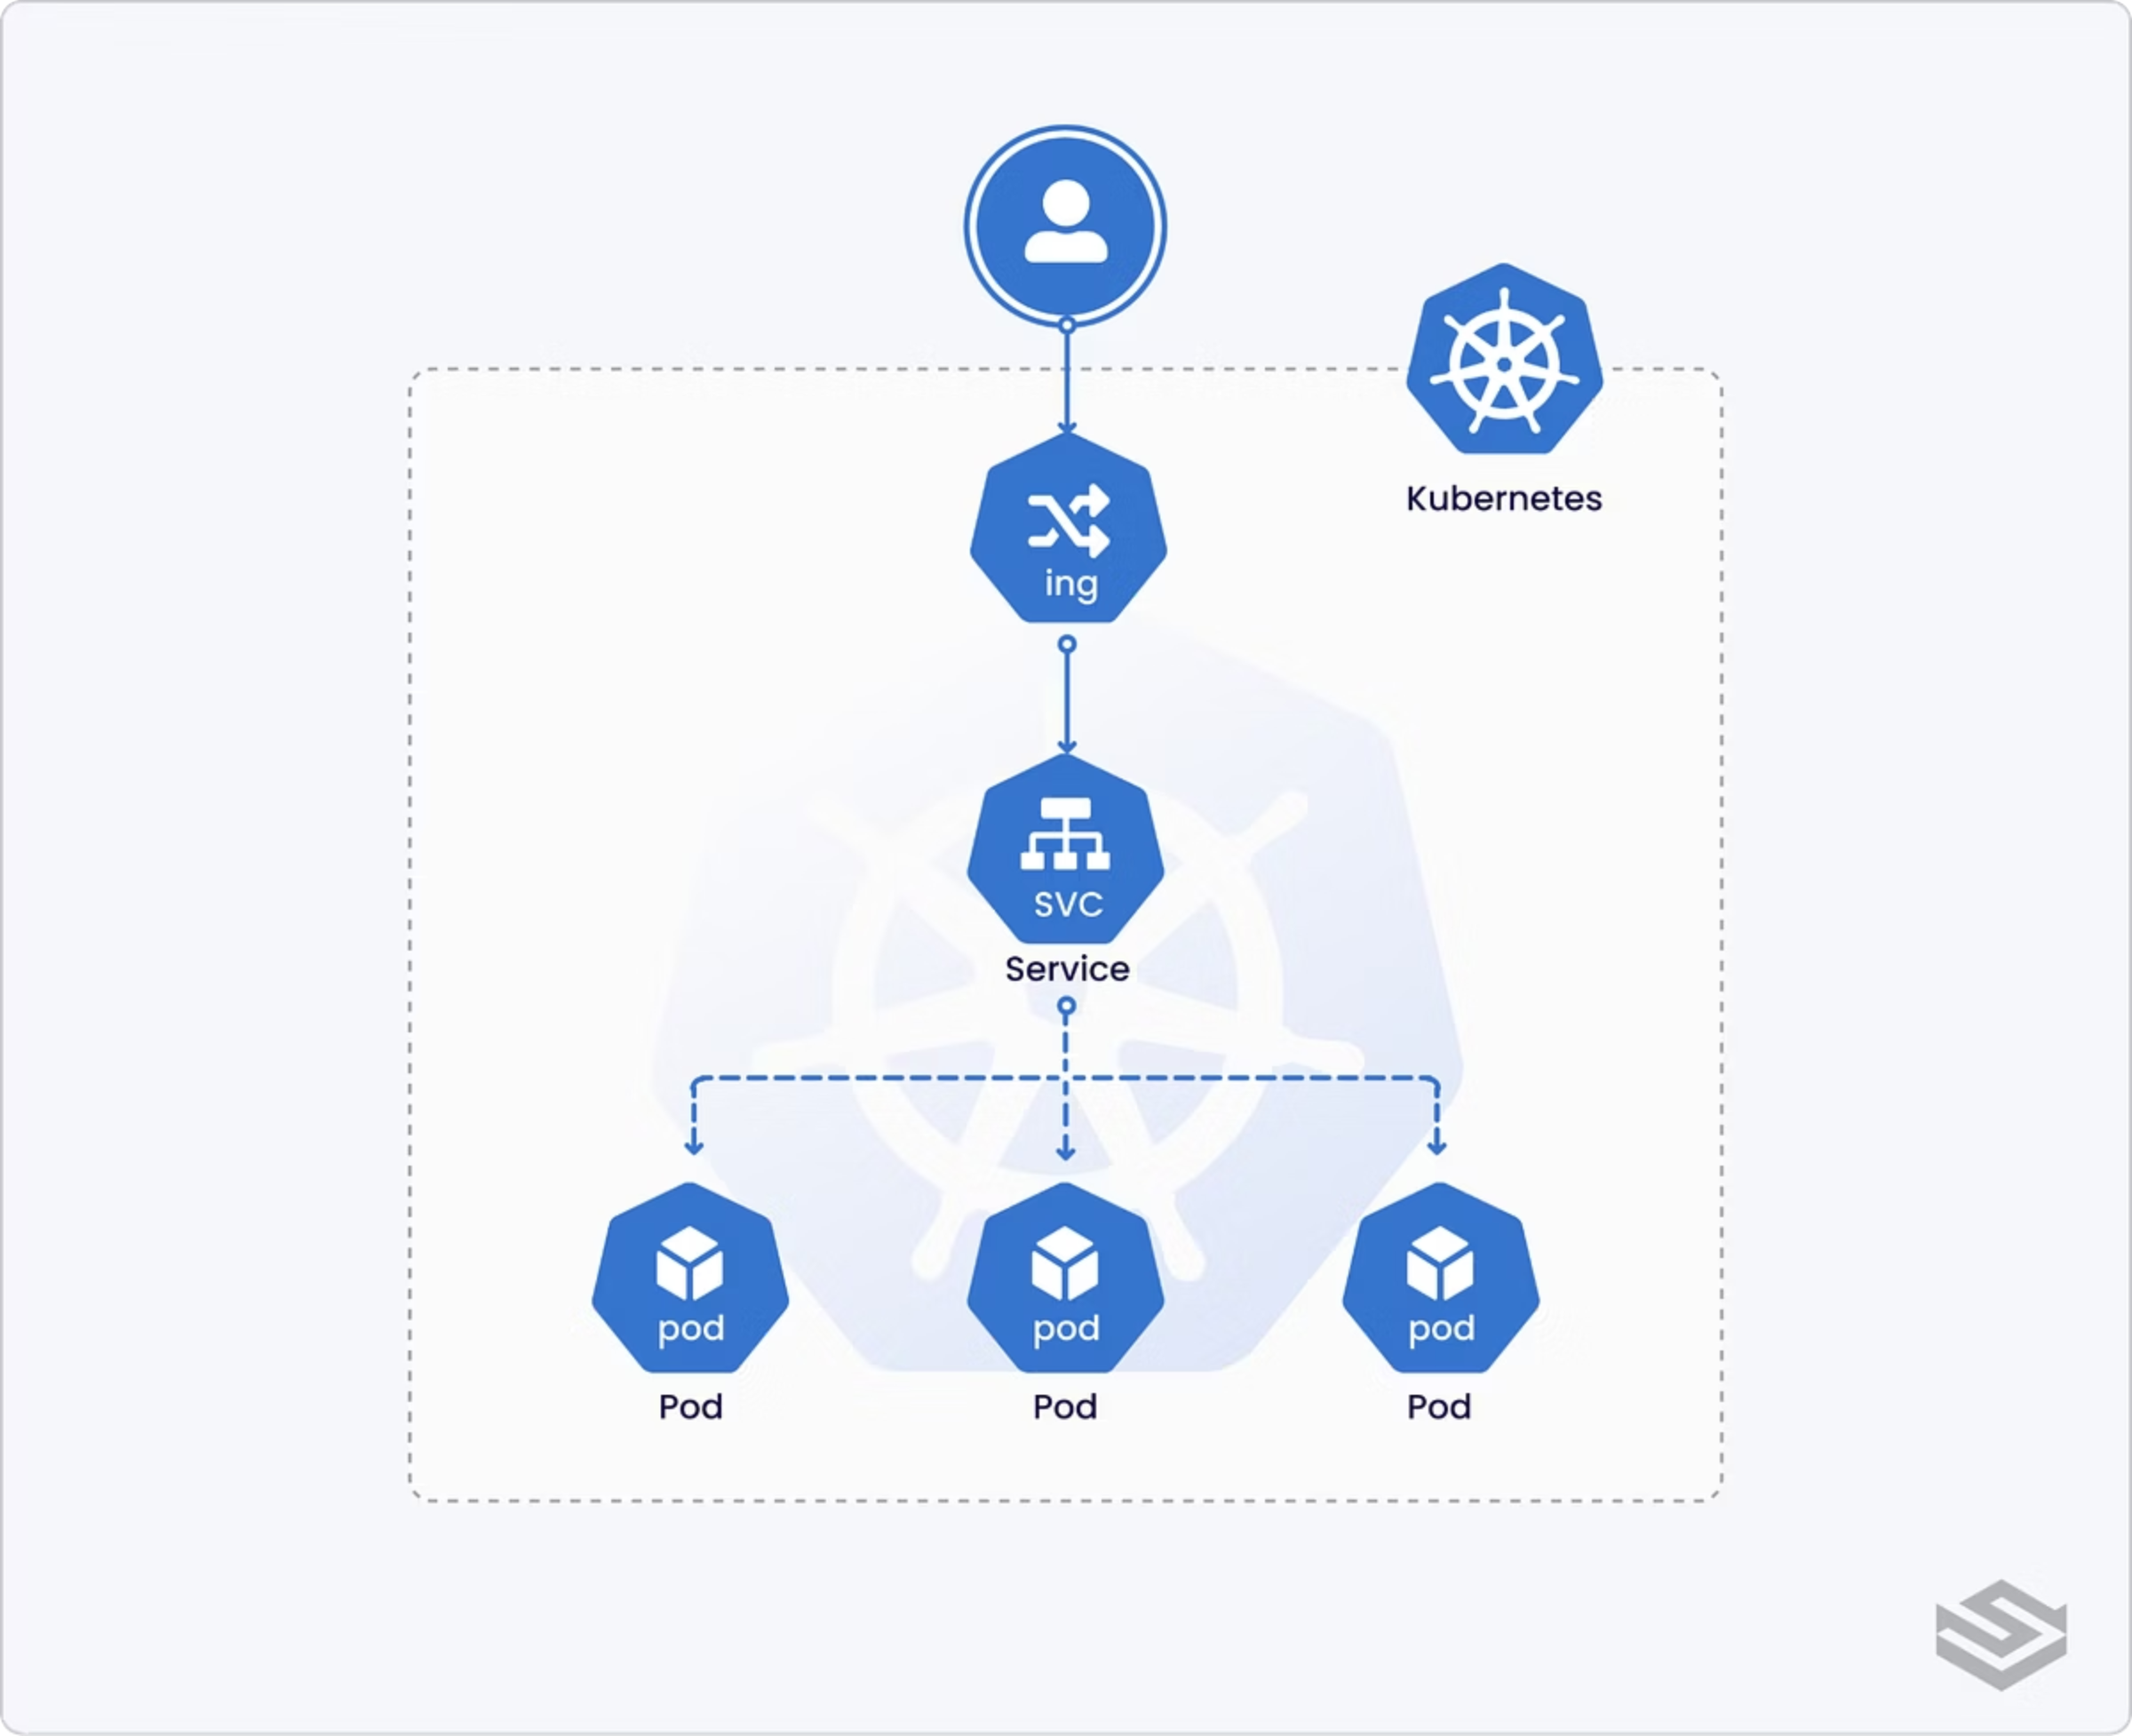
Ingress in Action: The NGINX Example
An Ingress resource defines how external HTTP/HTTPS traffic is routed into your Kubernetes services. Let's look at a simple NGINX Ingress configuration to understand its core components and how traffic flows.
Ingress Resource Explained
Traffic Flow: example.com
This YAML snippet creates an Ingress resource named web-ingress. It specifies rules for routing traffic based on the hostname and path.
When a request comes in for example.com, the Ingress Controller (in this case, NGINX) checks its rules. The path: / combined with pathType: Prefix means any request starting with / (i.e., all traffic) for example.com will be matched.
Routing to Service
Matched traffic is then directed to the specified backend: the Kubernetes Service named nginx-svc on port 80. This effectively routes external web traffic directly to your application running inside the cluster.
The Ingress Configuration
apiVersion: networking.k8s.io/v1kind: Ingressmetadata: name: web-ingressspec: rules: - host: example.com http: paths: - path: / pathType: Prefix backend: service: name: nginx-svc port: number: 80

Slide 9
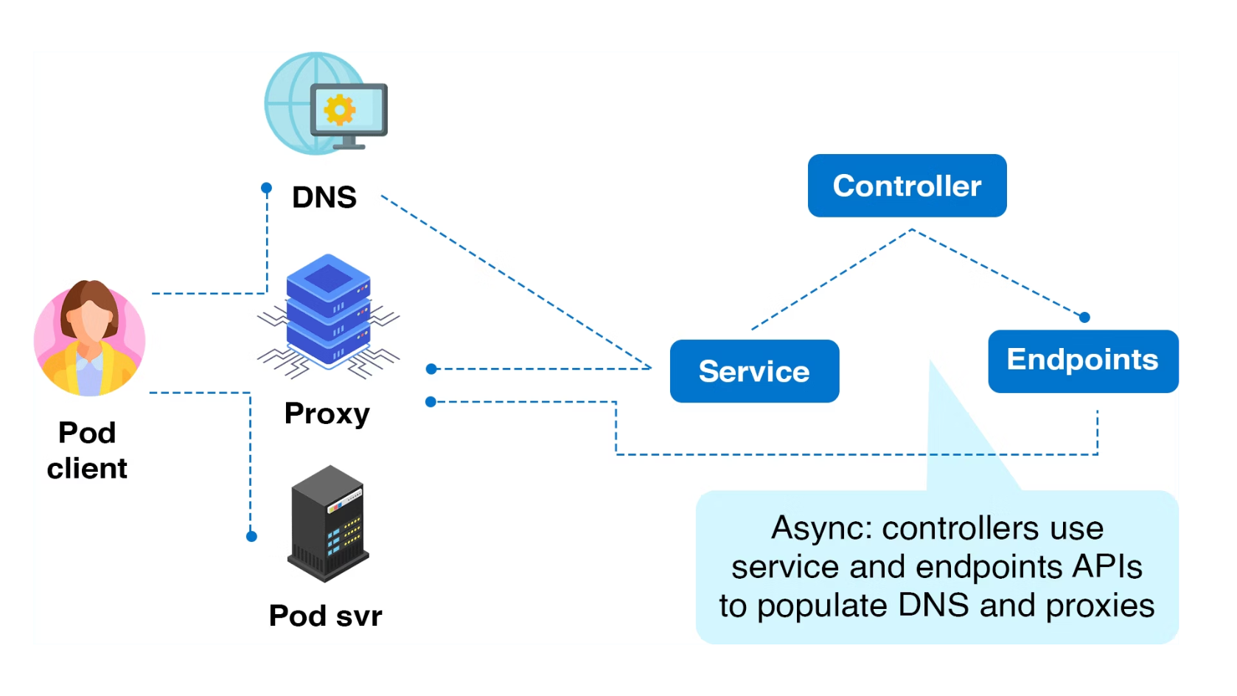

DNS in Kubernetes: Enabling Service Discovery
Kubernetes leverages an internal DNS service, CoreDNS, to simplify how applications find each other.
Automatic Naming
Every Service created in Kubernetes automatically receives a unique DNS name.
Predictable Format
These names follow a standard format: <service-name>.<namespace>.svc.cluster.local.
Pod Resolution
Pods can easily resolve these service names directly, eliminating the need to hardcode IP addresses.
This dynamic naming mechanism enables seamless service discovery, allowing your applications to connect and communicate without being tied to specific network locations.
Consider a Pod needing to connect to a MySQL database running as a Kubernetes Service:
mysql.default.svc.cluster.local# or, if in the same namespace:mysql
This simple naming makes your applications more resilient and portable within the cluster.
Speaker Notes: DNS is a critical component of Kubernetes networking that enables service discovery. CoreDNS, the default DNS server in Kubernetes, automatically creates DNS records for all Services. This means applications can refer to other services by name rather than IP address, which is essential since IPs can change. The full DNS name follows a predictable format: service-name.namespace.svc.cluster.local. However, if you're connecting to a service in the same namespace, you can simply use the service name. This DNS-based service discovery is what allows Kubernetes applications to be loosely coupled and resilient to changes in the underlying infrastructure.

Slide 10

Network Policies: Securing Pod Communication
In Kubernetes, communication between Pods is open by default. Network Policies act as a firewall, allowing you to define precise rules for how your Pods can interact. They are crucial for enforcing security boundaries and isolating workloads.
backend Pod
frontend Pod
admin Pod
Network Policy
This diagram illustrates how Network Policies provide granular control over Pod-to-Pod communication, restricting traffic based on specific criteria.
Key Aspects of Network Policies
Policy Example: Backend Access
Default Openness
apiVersion: networking.k8s.io/v1kind: NetworkPolicymetadata: name: backend-policyspec: podSelector: matchLabels: role: backend ingress: - from: - podSelector: matchLabels: role: frontend ports: - protocol: TCP port: 80
Without policies, all Pods in a cluster can communicate freely, which is often not desirable for security.
Controlled Communication
Policies allow you to define rules for inbound (ingress) and outbound (egress) traffic for selected Pods.
Rule Criteria
Rules can be based on Pod labels, namespaces, IP ranges, and specific ports.
CNI Requirement
Network Policies are enforced by the Container Network Interface (CNI) plugin (e.g., Calico, Cilium). Without a supporting CNI, policies will have no effect.
This policy specifically allows incoming connections to Pods with the label role: backend only from Pods labeled role: frontend, and only on TCP port 80. All other incoming traffic to the backend Pods will be blocked.
Speaker Notes: Network Policies are Kubernetes' firewall rules. By default, Kubernetes has an open network where any Pod can communicate with any other Pod. This is convenient but not secure for production environments. Network Policies let you define exactly which Pods can communicate with each other and on which ports. The example shown restricts access to backend Pods so that only frontend Pods can communicate with them on port 80. It's important to note that Network Policies are only enforced if you're using a CNI plugin that supports them, such as Calico or Cilium. If you're using a CNI that doesn't support Network Policies, like Flannel, these rules will be ignored.

Slide 11






Lab Exercise: Kubernetes Networking Essentials (15 min)
This hands-on lab will guide you through key Kubernetes networking concepts, from internal service exposure to external access and policy enforcement.
Expose Internal Service (ClusterIP)
Expose External Service (NodePort)
Deploy Ingress for External Access
Create a Service accessible only within the cluster.
Change the Service type to make it accessible from outside the cluster via Node IP.
Apply the Ingress YAML (from Slide 7) to route external traffic.
kubectl expose deployment nginx --port=80 --type=ClusterIP
kubectl edit svc nginx
curl -H "Host: example.com" http://<node-ip>
(Change type field to "NodePort")
Verify Service Discovery (DNS)
Implement Network Policy
Confirm CoreDNS resolves Service names correctly from within a Pod.
Create a policy to restrict backend Pod traffic to frontend Pods only.
(Requires Pods with appropriate labels for testing)
kubectl exec -it <pod> -- nslookup nginx-svc
Speaker Notes: Now it's time to put theory into practice with this hands-on lab. We'll work through creating different types of Services, deploying an Ingress resource, verifying DNS resolution, and applying Network Policies. The NGINX Ingress Controller has been pre-installed in your lab environment to save time. When testing the Ingress, you'll need to use the Host header since we're accessing it directly by IP. For the Network Policy exercise, you'll need to create Pods with appropriate labels to test that the policy is working correctly. I'll be walking around to help if you encounter any issues during the lab.

Slide 12







Summary: Kubernetes Networking Essentials
Flat Networking Model
Pods
Every Pod gets a unique IP address, enabling direct communication across nodes without NAT.
Services
Services
Ingress
Abstracts Pods with stable endpoints: ClusterIP (internal), NodePort, and LoadBalancer (external).
CoreDNS
Ingress
We've covered the foundational elements of Kubernetes networking. Understanding how these components interact is key to building robust and secure applications in your cluster.
Manages external access to services within the cluster via advanced HTTP/HTTPS routing rules.
CoreDNS
Any questions?
Provides robust service discovery, allowing applications to find services using DNS names.
Additional resources:
Kubernetes Networking Guide
Network Policies
Service & Ingress documentation
Enforces security by controlling traffic flow at the IP address or port level for Pods.
Network Policy examples
Speaker Notes: To wrap up, we've covered the five key aspects of Kubernetes networking. The flat networking model provides the foundation, allowing Pods to communicate directly. Services build on this by providing stable endpoints that abstract away the ephemeral nature of Pods. Ingress controllers add sophisticated HTTP routing capabilities. CoreDNS enables service discovery through DNS names. And finally, Network Policies allow you to secure your cluster by controlling Pod-to-Pod communication. Understanding these concepts is essential for running production workloads in Kubernetes. Are there any questions about what we've covered today? I'm happy to dive deeper into any specific area that interests you.

